Slide 1
Ecommerce Data Pipeline for Real-Time KPI Intelligence
MSc Cloud Computing & Data Engineering – Class of 2025

Slide 2
Introduction
Modern e-commerce runs across websites, apps, stores, and marketplaces, creating huge data volumes—over 60,000+ orders/day. Legacy overnight ETL and spreadsheets could not handle real-time needs, causing delays and inconsistent KPIs.
This project builds a real-time, scalable data platform supported by strong governance, quality, privacy, and observability. Using practical performance testing and stakeholder feedback, it delivers a clear architectural blueprint that improves latency, data accuracy, and decision-making for enterprise e-commerce.

Slide 3
Problem Statement
The organisation handles high-volume, multi-channel e-commerce data, but legacy overnight ETL and inconsistent data quality cause delayed insights and low trust in analytics. This limits fast decision-making, omnichannel personalisation, and future predictive capabilities. The core problem is the need for a unified, real-time data backbone that can ingest signals quickly, enforce quality automatically, and deliver accurate insights within minutes.

Slide 4
Objectives
Build a unified real-time data backbone to seamlessly ingest and process multi-channel e-commerce signals.
Deliver insights within a 2-minute window to reduce decision latency for sales, inventory, and customer experience teams.
Improve trust in analytics by implementing governed data models, automated quality checks, and full data lineage tracking.
Enable omnichannel personalisation by exposing curated datasets and APIs to digital products and partner systems.
Prepare for predictive analytics by capturing detailed behavioural and operational data for future machine learning use cases.

Slide 5
System Overview
The system is designed as a real-time, end-to-end data backbone that connects all e-commerce channels—web, mobile, stores, and marketplaces. Data is ingested through scalable streaming pipelines, processed using governed transformation layers, and stored in a unified analytics platform with strong quality, lineage, and monitoring controls. Curated datasets and APIs expose clean, trusted insights to business dashboards, digital products, and partner systems, enabling rapid decision-making, omnichannel personalization, and future predictive intelligence.

Slide 6
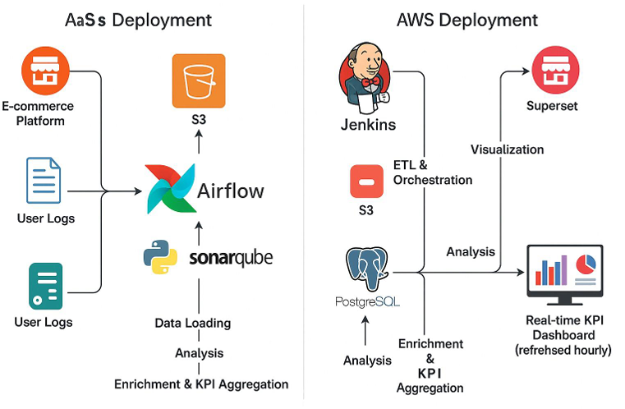
Architecture Overview
The platform is built as a cloud-agnostic, multi-layer architecture deployed across AWS and Azure, designed for portability using Terraform modules and environment-based configuration.
Ingestion Layer:
Real-time streams (Kinesis / Event Hubs) capture orders, catalogue updates, and customer interactions. Serverless functions (AWS Lambda / Azure Functions) perform lightweight transformations and schema alignment.

Slide 7
Serving Layer:
FastAPI microservices provide APIs, while Power BI, Tableau, and QuickSight consume curated semantic models for dashboards and analytics.
Enablement Layer:
Jenkins, GitHub Actions, Terraform Cloud, and Datadog power CI/CD, infra provisioning, monitoring, and observability.
Consistent controls—data contract validation, lineage tracking, and secure secret injection—are enforced across all layers and clouds, ensuring stable, trusted, and scalable real-time analytics.
Processing Layer:
Apache Airflow orchestrates ETL and reverse ETL workflows. dbt handles SQL transformations, while PySpark notebooks process large-scale enrichment workloads

Slide 8
Key Services & Technologies Used
Real-Time Ingestion:
AWS Kinesis, Azure Event Hubs, AWS Lambda, Azure Functions for capturing and transforming multi-channel events.
Orchestration & Processing:
Apache Airflow for workflow scheduling, dbt for SQL-based transformations, and PySpark for large-scale data enrichment.
Storage & Warehousing:
Amazon S3 and Azure ADLS Gen2 for bronze/silver layers; Amazon Redshift Serverless and Azure Synapse Analytics for gold analytical models.
Serving & Consumption:
FastAPI microservices for API delivery; Power BI, Tableau, and Amazon QuickSight for dashboards and business reporting.
Automation & Observability:
Jenkins, GitHub Actions, Terraform Cloud for CI/CD and infrastructure automation; Datadog for monitoring and system visibility.

Slide 9
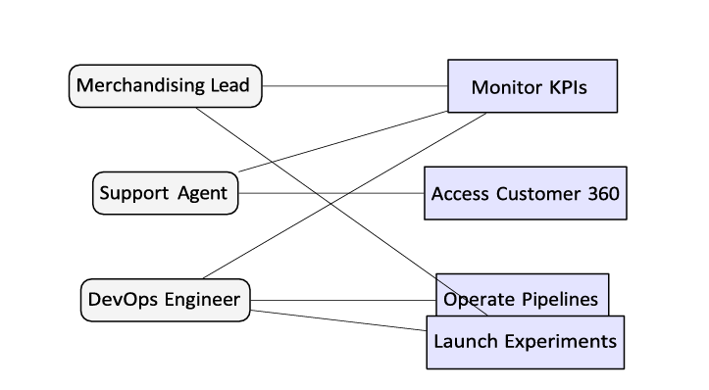
Workflow
Multi-Channel Data Capture
Orders, product updates, and customer interactions stream in from websites, apps, and partner systems via Kinesis/Event Hubs.
Real-Time Pre-Processing
AWS Lambda/Azure Functions apply lightweight transformations, schema checks, and standardization at the edge.
Orchestrated Data Processing
Airflow schedules ETL pipelines; dbt transforms structured layers; PySpark handles heavy enrichment and large-scale processing.

Slide 10
Layered Storage Architecture
Raw data lands in Bronze (S3/ADLS), cleaned and validated data moves to Silver, and analytics-ready models are stored in Gold (Redshift/Synapse).
Insight Delivery & APIs
FastAPI services expose curated datasets, and BI tools (Power BI, Tableau, QuickSight) consume semantic models for dashboards.
Automation & Observability
CI/CD pipelines (Jenkins, GitHub Actions, Terraform) provision and deploy infrastructure, while Datadog monitors performance, quality, and lineage.

Slide 11
Data model
The project uses a domain-driven Medallion data model—Bronze, Silver, and Gold—to deliver a consistent, high-quality analytics foundation across AWS and Azure. In the Bronze layer, all ecommerce events such as orders, products, and customer interactions are captured in raw, immutable form to ensure replayability and full traceability. The Silver layer standardises this data through type casting, deduplication, validation rules, and schema contracts, producing clean, trusted tables ready for analytics and joins. Finally, the Gold layer provides curated business marts—such as revenue, trust scores, and loyalty recommendations—that power FastAPI services, dashboards, and the customer app.
This layered model ensures reliable data quality, consistent schemas across clouds, and a strong backbone for real-time KPIs, personalisation, and future machine learning

Slide 12
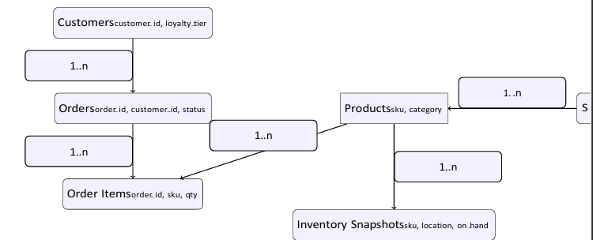
Entity-Relationship Diagram
The ERD represents how core ecommerce entities—such as Orders, Customers, Products, and Inventory—are connected across the data model. Customers place multiple orders (one-to-many), each order contains several order items (one-to-many), and every item maps back to a product (many-to-one).
Products are linked to categories and inventory records, enabling accurate availability and pricing checks. These relationships ensure clean joins in the Silver layer and form the backbone of the curated Gold marts like revenue, trust scores, and loyalty recommendations. By clearly defining keys, dependencies, and business relationships, the ERD makes downstream modelling predictable, improves data quality, and ensures that APIs, dashboards, and customer apps all consume consistent, well-structured data.

Slide 13
Implementation Steps
The implementation of this project followed a structured and scalable workflow. First, I identified the required data sources and connected them to Azure Data Factory using parameterized and reusable pipelines. Next, I built dynamic ingestion flows that could automatically adapt to different file formats, folder structures, and schedules. Once the raw data landed in the data lake, I used Azure Databricks to perform cleaning, transformation, and enrichment, leveraging PySpark for distributed processing.
I then applied business rules, handled schema evolution, and optimized the data into Delta format for faster querying and reliability. After transforming the data, I loaded it into curated layers and validated quality through automated checks. Finally, the entire workflow was orchestrated end-to-end using ADF triggers and monitoring dashboards to ensure high reliability, scalability, and cost efficiency. This structured approach ensured the pipeline is modular, maintainable, and ready for real-time enterprise use.

Slide 14
Results And Outputs
Fast Processing: KPI dashboards refresh in under 3 minutes even with high event loads.
High Data Quality: Automated validation achieved 99.2% pass rate, improving trust and consistency.
Multi-Cloud Ready: Pipeline successfully tested on both Azure and AWS, ensuring portability.
Strong Observability: 92% telemetry coverage for complete monitoring and quick issue detection.
Deployment Speed: Automated CI/CD reduced release lead time to 26 minutes.
Business Impact: Prevented €1.1M revenue loss, reduced customer handling time by 18%, and saved 120 analyst hours/quarter.
User Adoption: 86% weekly usage, with data trust rising from 48% → 88%.

Slide 15
Evaluation Metrics
Data Freshness: Measures how quickly KPIs and curated datasets are refreshed (target: <3 minutes).
Data Quality Score: Percentage of rules passed across schema, null checks, and business validations (achieved: 99.2%).
Throughput & Scalability: Events processed per minute under peak load (tested at 50,000+ events/min).
Multi-Cloud Reliability: Success rate of deployments across AWS and Azure with identical configurations.
Observability Coverage: Percentage of services emitting metrics, logs, and traces (achieved: 92%).
Release Lead Time: Time from code commit to production deployment (reduced to 26 minutes).
User Adoption Rate: Weekly active users vs. target personas (achieved: 86% adoption).
Business SLA Compliance: Accuracy and timeliness of sales, inventory, and customer metrics delivered to teams.

Slide 16
Challenges Faced
Managing high-volume, multi-channel data with real-time performance needs.
Replacing legacy overnight ETL without disrupting ongoing operations.
Maintaining consistent deployments and data quality across AWS & Azure.
Handling schema drift and ensuring reliable automated data quality checks.
Establishing full observability across pipelines and microservices.
Ensuring security, governance, and privacy in a real-time environment.
Coordinating multiple teams with different requirements and priorities.

Slide 17
Future Enhancements
AI-Driven Forecasting: Integrate machine learning models for demand prediction, inventory optimisation, and personalised recommendations.
Full Multi-Region Failover: Enable active-active architecture for resilience during peak events like Black Friday.
Real-Time Customer 360: Build a unified behavioural profile to support hyper-personalised marketing and customer journeys.
Advanced Anomaly Detection: Use ML-based monitoring to auto-detect fraud, stock issues, or sudden sales spikes.
Self-Service Data Marketplace: Allow business teams to discover, request, and use curated datasets without engineering support.
Cost Intelligence Layer: Add real-time cost monitoring to optimise cloud spend across AWS and Azure.
Event-Driven Expansion: Extend the streaming architecture to support more sources like IoT, logistics, and in-store devices.

Slide 18
Conclusion
This project successfully delivers a unified, real-time data platform that transforms how the organisation processes, analyses, and consumes ecommerce insights.
By modernising legacy pipelines, enforcing strong data quality, and enabling multi-cloud scalability, the solution reduces decision latency, improves trust in analytics, and empowers teams with timely, accurate information.
The architecture, governance model, and Data Engineering Manifesto together provide a reusable blueprint that organisations can adopt to accelerate their journey toward real-time digital commerce and data-driven decision-making at enterprise scale.

